Slide 1
CONFIDENTIAL
Using LastPass

Slide 2
CONFIDENTIAL
Why Use LastPass?
Great password management is impossible w/o a great tool
Auto-fill (hands-free login) will save you approximately 1 hour per month
You will never feel the frustration of a forgotten password again
Fewer calls to the helpdesk
Better security for company tools and data

Slide 3
CONFIDENTIAL
Why Use LastPass?
Welcome email walks you thru downloading LastPass and creating your account
For your Master Password, consider using a passphrase (I like 2 go 2 the beach!) instead of password
Your Master Password is the last password you will have to remember
Login to LastPass
Stores sites as you go (no personal data please)
Handsfree login after that!
Getting Started with LastPass Video Tutorial:
https://www.youtube.com/watch?v=tx8tnVX8z7w&feature=player_embedded

Slide 4
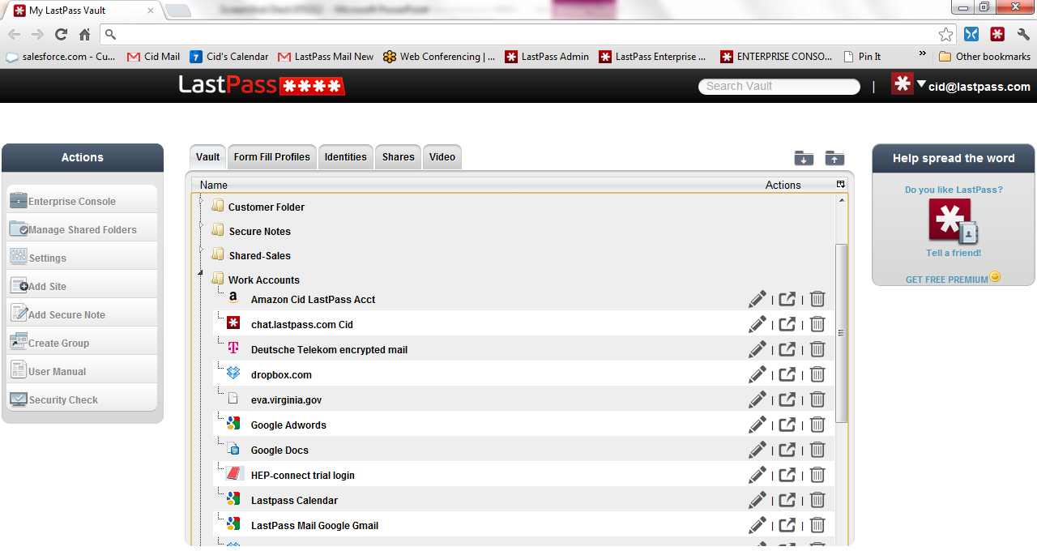
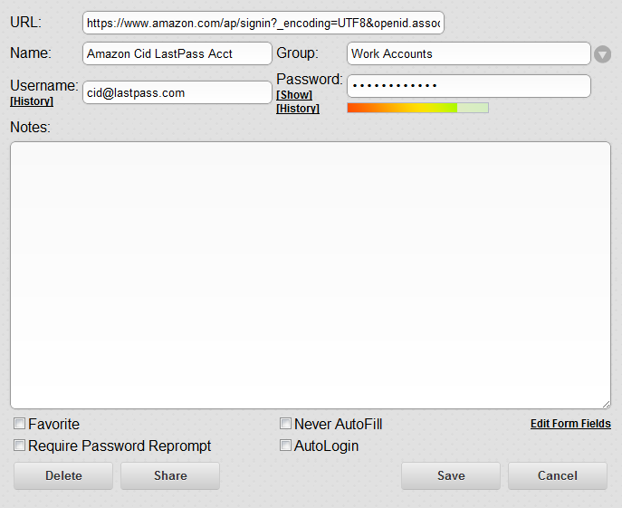
CONFIDENTIAL
Your LastPassVault (accessed via the Plug-in or from www.lastpass.com)
The LastPass Plug-in
Red Icon = Logged-on
Gray = Logged-off
Collapse and Expand All Folders
Edit
Launch
Delete
‘Group’

Slide 5
Step 1: Browse to the desired site and log in. Step 2: Note the prompt in the notification bar. Hit ‘save site’. Step 3: Fill out the ‘edit’ form with your preferences for the site.
CONFIDENTIAL
Logging in and Saving Existing Credentials
If the site has only 1 related login, then you might want to select ‘auto-login’
If the site is particularly sensitive (financial services), then you might want to select ‘Require Password Reprompt’.
Assign to a group to keep your vault well-organized.
**Please do not store personal data to your Enterprise vault.
Instead, create a separate personal account and link the two.
User Manual: http://helpdesk.lastpass.com/password-manager-basics/adding-a-site/
Link a personal acct: http://enterprise.lastpass.com/getting-started/link-personal-accounts/

Slide 6
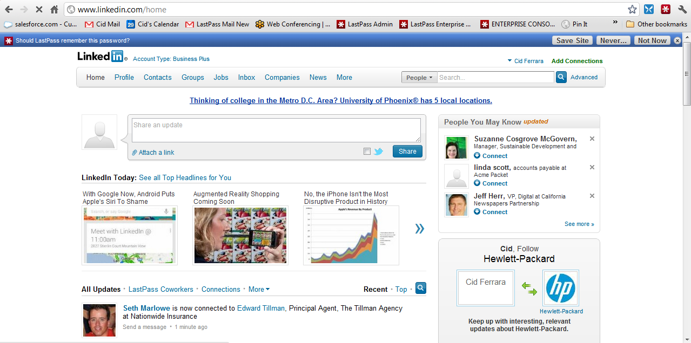
CONFIDENTIAL
Saving Existing Credentials

Slide 7
‘Save all entered data (SAED)’ can be used for storing non-standard and troublesome logins such as multi-page login screens or floating screens. Rather than saving just the login data, ‘SAED’ allows you to capture and store every field on the page. Step 1: Browse to the desired site and enter username and password. Step 2: Prior to hitting the submit button, go to the plug-in and select ‘SAED’. Step 3: Fill out the ‘edit’ form with your preferences for the site and hit ‘save’.
CONFIDENTIAL
Save All Entered Data
User Manual: http://helpdesk.lastpass.com/login-problems/

Slide 8
Step 1: Browse to the desired site as you normally would: by typing in the URL, or by clicking on the bookmark. Step 2: When you arrive at the login screen LastPass will automatically fill in the username and password fields. If you have ‘auto-fill’ set, then simply hit the submit button to login to the site. If you have multiple accounts, then select the right account from the auto-fill dropdown options. If you have ‘auto-login’ set, then LastPass will automatically hit the submit button for you. Troubleshooting: (1) If LastPass does not take action, first check to make sure that the LastPass icon in the browser bar is red. Red = logged-on. Gray = logged-off. (2) If the icon is red, then look for the ‘auto-fill’ button in the notification bar. Click it to fill in the username and password. (3) If you are still experiencing problems, then this may be a non-standard login page. In this case, try saving the site again using ‘Save all Entered Data’.
CONFIDENTIAL
Visiting a Saved Site – “Hands-free Login”
LastPass: The LAST password you’ll have to remember!

Slide 9
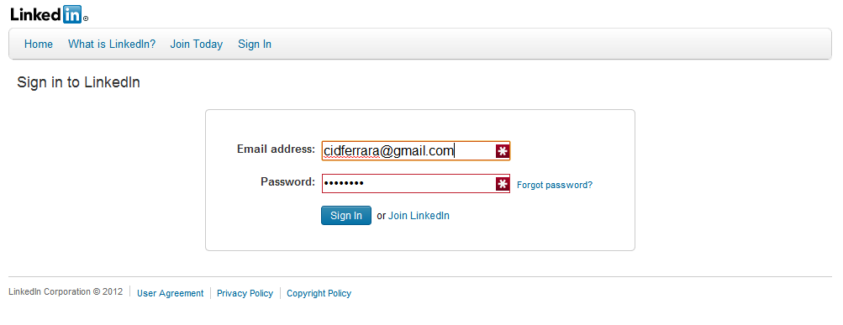
CONFIDENTIAL
Logging in with Stored Credentials (Auto-Fill)

Slide 10
Step 1: Browse to the site in question. Sign in to your account on the Website. Find and select the ‘update password’ option. Step 2: As you are filling out the form and you place your cursor in the password field, note the notification bar at the top of the window. Select ‘Generate password’. The password will automatically be copied into the password fields. Step 3: Save/submit the change. Note the notification bar. Select ‘confirm’. The password has been updated and safely stored in your vault. User Manual: http://helpdesk.lastpass.com/password-manager-basics/generating-a-password/changing-the-password-for-a-stored-site-to-a-generated-password/
CONFIDENTIAL
Updating Existing Login Credentials

Slide 11
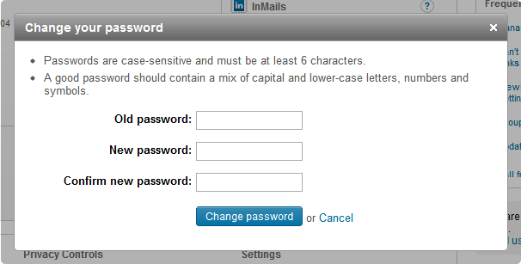
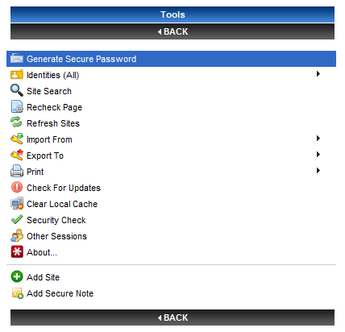
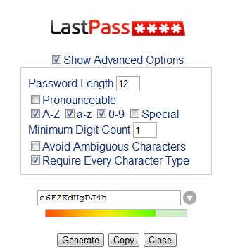
CONFIDENTIAL
Updating Passwords Using ‘Generate Password’ Tool

Slide 12
Step 1: Browse to the new site and find the ‘register’ page. Step 2: Click on the password field and note the notification bar. Select ‘Generate’. Step 3: Complete and submit the registration form. (Do not hit the ‘Save Site’ button at this time or it will save the incorrect URL.) Step 4: Find and select ‘log-off’. Step 5: Find and select ‘log-in’. Step 6: Click on the LastPass icon in your browser. Scroll to the bottom of the menu and select ‘Copy generated password’. Paste into password field. Step 7: Submit the page. Note the notification bar. Select ‘Save Site’.
CONFIDENTIAL
Creating and Saving New Credentials
If the site has only 1 related login, then you might want to select ‘auto-login’
If the site is particularly sensitive (financial services), then you might want to select ‘Require Password Reprompt’.
Assign to a group to keep your vault well-organized.

Slide 13
Always edit/update and store credentials at the Site, never in the LastPass vault. If a site is not logging you in properly:
CONFIDENTIAL
Tips and Tricks
Go to your vault -> edit.
Verify username and password fields.
Copy and paste the username and password into the login screen manually. If this does not work, then it is likely that incorrect info was stored in LastPass.
If LastPass is taking you to the wrong page of the site, then you have probably not saved the login URL of the site. To correct: surf to the login screen of the site, copy the full URL, click on the plug-in -> my LastPass vault -> ‘edit’ next to the site in question -> paste the copied URL into the URL space.
If all else fails, write down the password, delete the entry from your vault, and start over.

Slide 14
AUTOMATED Form Fill: http://helpdesk.lastpass.com/fill-form-basics/ Using LastPass to store the data you typically have to type into web forms is both easy and secure. Your data is encrypted locally on your computer with the key that only you know before it is sent to LastPass, so you can securely store your credit card, ssn, phone number, and other sensitive data you wish to easily access. Secure notes: http://helpdesk.lastpass.com/password-manager-basics/secure-notes/ LastPass Secure Notes allow you to store private information safely and securely. Think of it as a password-protected, digital notepad that you can access from anywhere, at anytime. Some examples of data that you might save in a secure note include bank account numbers, social security numbers of your family members, passport numbers, combinations to safes, etc. Security challenge: https://lastpass.com/index.php?securitychallenge=&fromwebsite=1&lpnorefresh=1 Storing your logins with LastPass is just the first step. Now you need to generate random, secure passwords for all of your sites. Having identical or similar passwords for multiple websites is extremely dangerous, because access to one account becomes equivalent to access to all of your accounts. The Security Challenge will help you determine where you're at, and give you steps for improving your security with LastPass. As always with LastPass, all encryption and decryption is done 100% locally on your machine. All unencrypted passwords are tested with local checks only.
CONFIDENTIAL

Slide 15
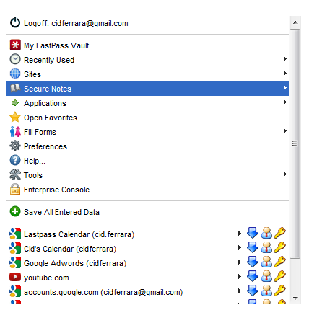
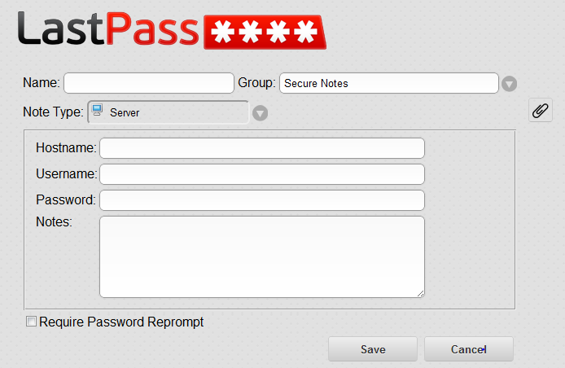
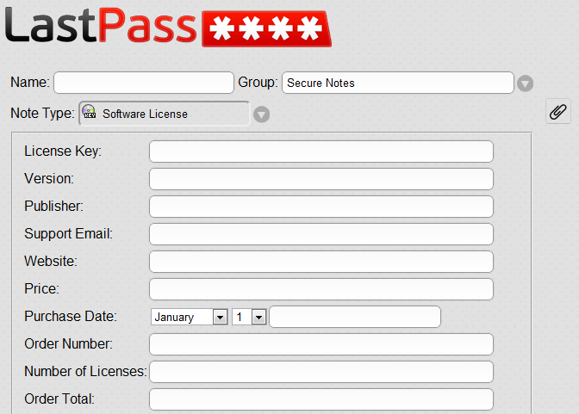
CONFIDENTIAL
Updating Passwords Using ‘Generate Password’ Tool

Slide 16
CONFIDENTIAL
LastPass for Applications
(Windows Only)

Slide 17
Step 1: Open the application that you wish to save. Step 2: Click the LastApp icon in the system tray and select ‘add application’. Step 3: Click ‘find’, then click on the application window. Return to the LP window and click ‘next’. Step 4: Type the credentials into the LastApp form and select ‘auto-fill’, or hit ‘train’ (depends on the app.) Step 5: Hit ‘save’. At this point the new app will have been added to the list of stored apps. You can close all open windows.
CONFIDENTIAL
Saving Non-Web Based (Application) Credentials
User Manual: http://helpdesk.lastpass.com/password-manager-basics/adding-a-site/

Slide 18
Step 1: Click on the LastApp icon in the system tray and scroll up to ‘Applications’ and rest on the desired application. Then select ‘launch’ from the menu. Step 2: The stored credentials will auto-fill on the login form. Click the submit button to log-in.
CONFIDENTIAL
Launching a Saved App – “Hands-free” Login
LastPass: The LAST password you’ll have to remember!
User Manual: http://helpdesk.lastpass.com/password-manager-basics/adding-a-site/

